Slide 1


Cortical Origin of Frontal Asymmetry for Major Depressive Disorder
Dietta Laura Chihade

Slide 2
Outline
Introduction
Methods
Data Collection
Analysis
Results
EEG, MEG, MEG Cortical Space
Discussion

Slide 3
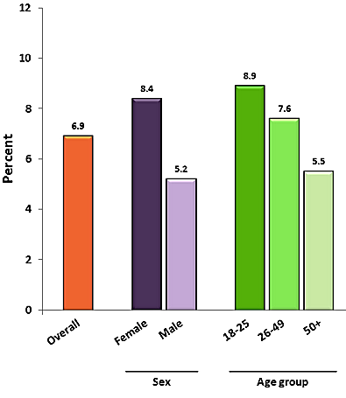
MDD is Common and Poorly treated
‘Depression’ refers to a spectrum of disturbances in mood that last for several weeks
Lifetime prevalence about 12%
Elevated mortality and comorbidity rate
Current treatments are insufficient
Prevalence of MDD Episodes among U.S. Adults
Source: World Health Organization, Mental Health Gap Action Programme, 2014
Notes:
http://whqlibdoc.who.int/publications/2008/9789241596206_eng.pdf
The disability-adjusted life year (DALY) is a measure of overall disease burden, expressed as the number of years lost due to ill-health, disability or early death.
A risk factor for suicide and many noncommunicable diseases such as stroke, coronary heart disease, and type 2 diabetes.
Comorbid depression is a predictor of adverse outcome – e.g. increased mortality after myocardial infarction.
Infection with HIV-1 is associated with increased occurrence of depression; adherence to antiretroviral therapy is adversely affected by comorbid depression. Adherence to antiretroviral therapy has been shown to improve when comorbid depression is treated.
Comorbid depression also affects adherence to treatment for other health conditions such as diabetes and tuberculosis.
Postpartum depression has negative consequences for the early relationship between mother and infant and for the child’s psychological development. Maternal depression is a risk factor for infant stunting. Mothers suffering from depression may delay seeking help for their child with potentially serious illnesses.
Major depression disorder according to the DSM-IV diagnosis:
Depressed mood most of the day, nearly every day, as indicated by either subjective report or observation by others
Markedly diminished interest or pleasure in all or almost all activities most of the day, nearly every day
Significant weight loss when not dieting or weight gain or decrease or increase in appetite
Insomnia or hypersomnia nearly every day
1/3 respond well to first medication trial
1/3 respond after multiple treatment pharmacotherapy trials
1/3 do not respond to medication
Fourth leading cause of disease burden disability adjusted life years (DALYs) globally and is projected to increase to second leading cause in 2030
Lifetime estimate of prevalence for major depressive disorder is 12%

Slide 4
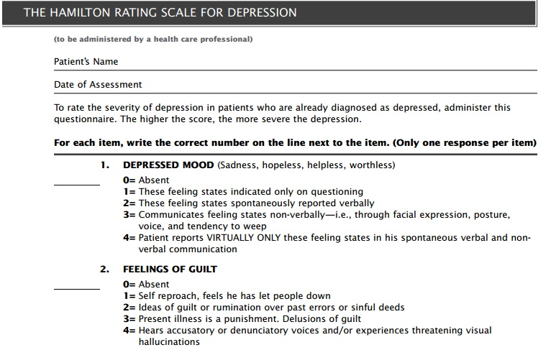
HAM-D Psychometric
Source: Strik J, et al. Psychosomatics. 2001; 42:423–428
Notes:
Diagnosis is based on subjective observations of the patient
Standards for screening inevitably vary between clinicians
There are no widely accepted objective tests

Slide 5
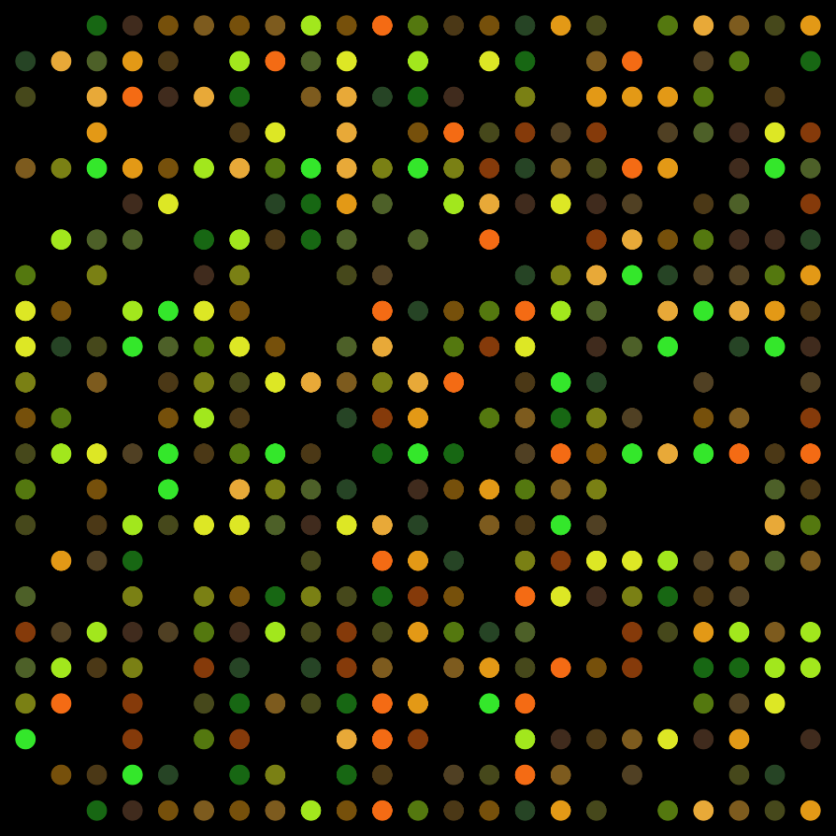
Biomarkers are potential objective diagnostic and prognostic tools
Biomarkers offer ‘biological cues’
Existing Biomarkers
Pathophysiological
Electrophysiological
Problems with existing biomarkers
Lack validity
Unrealistic for clinical setting
Source: Pajer et. al, Translational Psychiatry. 2012 2, e101; doi:10.1038/tp.2012.26
Notes:
Reduction of GABAergic processes leads schizophrenic symptoms.
Specific rat strain that is the best model for depression WKY WMI= depression WLI= healthy
Microarray analysis to find certain transcripts are more abundant. Molecular biology standpoint.
Blood Transcripts
Peripheral Growth Factors (IGF)
ERPs: P50 and P300

Slide 6
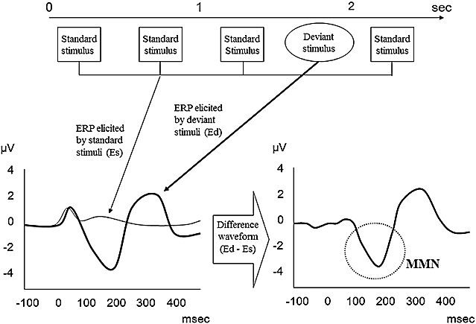
Electrophysiological measures are potential biomarkers
Source: Nagai et. al, 2013
Notes:
Mismatch negativity (ERP) for patients who are dyslexic or have aphasia less pronounced in MMN.
Poor auditory memory.
ERPs: P50 and P300

Slide 7
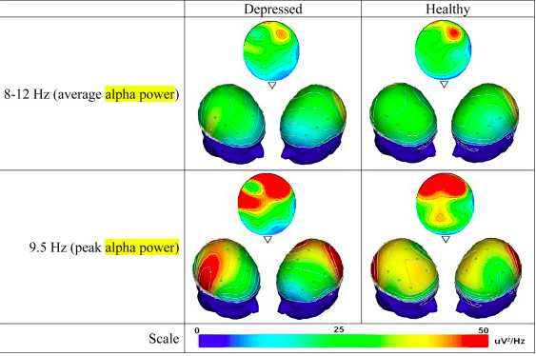
Frequency Domain EEG demonstrates Frontal Asymmetry
Source: Gollan et. al, 2014 Biological Psych. Figure 1
Notes:
In the frequency domain in frontal scalp electrodes (conflicting studies evidences some studies such as effect)
OBJECTIVE: Can we improve frontal asymmetry test?
Limitations of just approaching EEG
Perhaps we can improve frontal asymmetry test based scalp electrode locations
EEG signals don’t tell origin don’t neglect where the signal was generator (source of activation is coming from)
Frontal alpha asymmetry (FAA):
Allen, John J. B., and Michael X Cohen. “Deconstructing the ‘Resting’ State: Exploring the Temporal Dynamics of Frontal Alpha Asymmetry as an Endophenotype for Depression.” Frontiers in Human Neuroscience 4 (2010): 232. PMC. Web. 26 Jan. 2015.
Alpha power = ⬇ Neural activity in LEFT frontal regions of the brains of depressed patients (idling)
Alpha power = EYES CLOSED
That isto say, knowing where EEG activity takes place on the scalp does not in
turn give you certainty concerning where the activity originated in the
brain. Inverse problem
Frontal Asymmetry is a Potential Depression Biomarker
Some historical data suggest frontal asymmetry
PET and EEG
Conflicting data exists
Ambiguity of EEG source localization may account for the conflicts

Slide 8
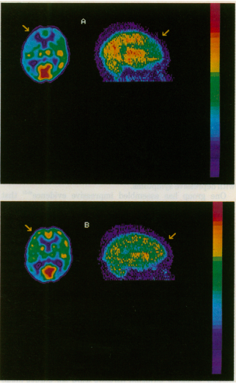
Positron Emission Tomography findings of Frontal Asymmetry
PET allows noninvasive, quantitative measures ; reliable with respect to source localization
⬇ Glucose Metabolic Rates and Cerebral Blood Flow in LEFT dorsal lateral prefrontal cortex (DLPFC) = ⬆ Severity of Depression
Baxter et. al
Notes:
Panel A shows the patient before treatment and panel B shows the patient after treatment with antidepressants.

Slide 9
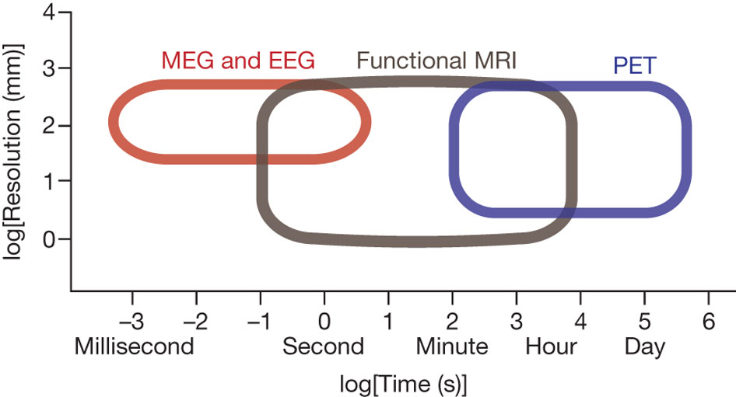
Functional neuroimaging methods and their temporal and spatial resolution.
Source: A Meyer-Lindenberg Nature 468, 194-202 (2010)
Notes:
Magnetoencephalography (MEG) and electroencephalography (EEG) image the electromagnetic effects of neuronal (assembly) action; their temporal resolution can be on the order of milliseconds whereas their spatial resolution tends to be less than that of fMRI, which images blood flow or oxygenation effects of neuronal activation, and PET, which uses radioisotopes to label molecules in the brain. fMRI and PET, in turn, are limited in their temporal resolution to several 100 ms (for fMRI) and minutes (for PET).

Slide 10
MEG and EEG Differ in Their Orientation Sensitivity
MEG only detects currents tangential relative to the volume conductor model
EEG detects both tangential and radial currents
Therefore:
MEG signal maxima are detected over their neuronal generators
The relation between EEG scalp electrodes and the underlying neuronal generators is complex
Source: http://www.allgpsy.unizh.ch/graduate/mat/180102/Lecture1.pdf

Slide 11
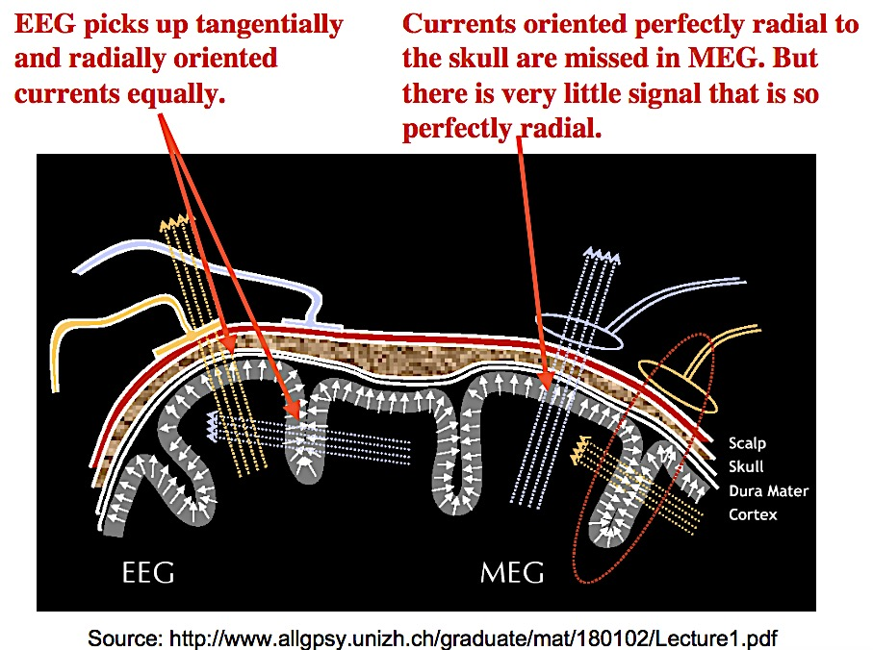
Notes:
the 10/20 system. Electrode locations are named in terms of brain areas
(e.g., F=frontal, T=temporal, C=central, P=parietal, O=occipital).
The millisecond temporal resolution of MEG and EEG is currently the best asset for neuroscientists to capture the complexity of electrophysiological activity emerging from many brain regions simultaneously

Slide 12
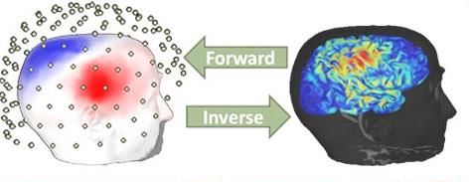
Cortical Space
Source: François Tadel and Sylvain Baillet, McConnell Brain Imaging Centre, Visualizations of brain activity estimated from MEG/EEG scalp recordings.
Notes:
The MEG/EEG space is coregistered with the MRI by aligning the sensors on the scalp surface of the subject.
Forward modeling with boundary element methods (BEMs) to compute a head model by mapping neural currents and MEG/EEG sensor measurements.

Slide 13
Aims
Aim 1: Is there a relationship between cortex neurophysiological characteristics measured with EEG/MEG and the severity/progression of MDD
Aim 2: Better understand the cortical origin of frontal asymmetry for MDD patients using EEG/MEG data

Slide 14
Hypotheses
Hypothesis 1 A/B: EEG/MEG and Cortical Space results differ between the MDD patient and the healthy control and with clinical improvement.
Hypothesis 2 A: EEG/MEG frontal asymmetry is generated in the frontal cortex , specifically in the superior, middle, and/or inferior frontal sulcus

Slide 15
Outline
Introduction
Methods
Data Collection
Analysis
Results
EEG, MEG, MEG Cortical Space
Discussion

Slide 16
Data Collection
MGH Depression and Clinical Research Program (DCRP)
EEG/MEG visit 1, EEG/MEG visit 2, and MRI visit
MDD subjects given FDA approved escitalopram (SSRI) for 8 weeks
EEG/MEG V1
EEG/MEG V2
MRI V3
8 weeks of SSRI
Notes:
Subject were recruited and screened for depression (MDD)

Slide 17
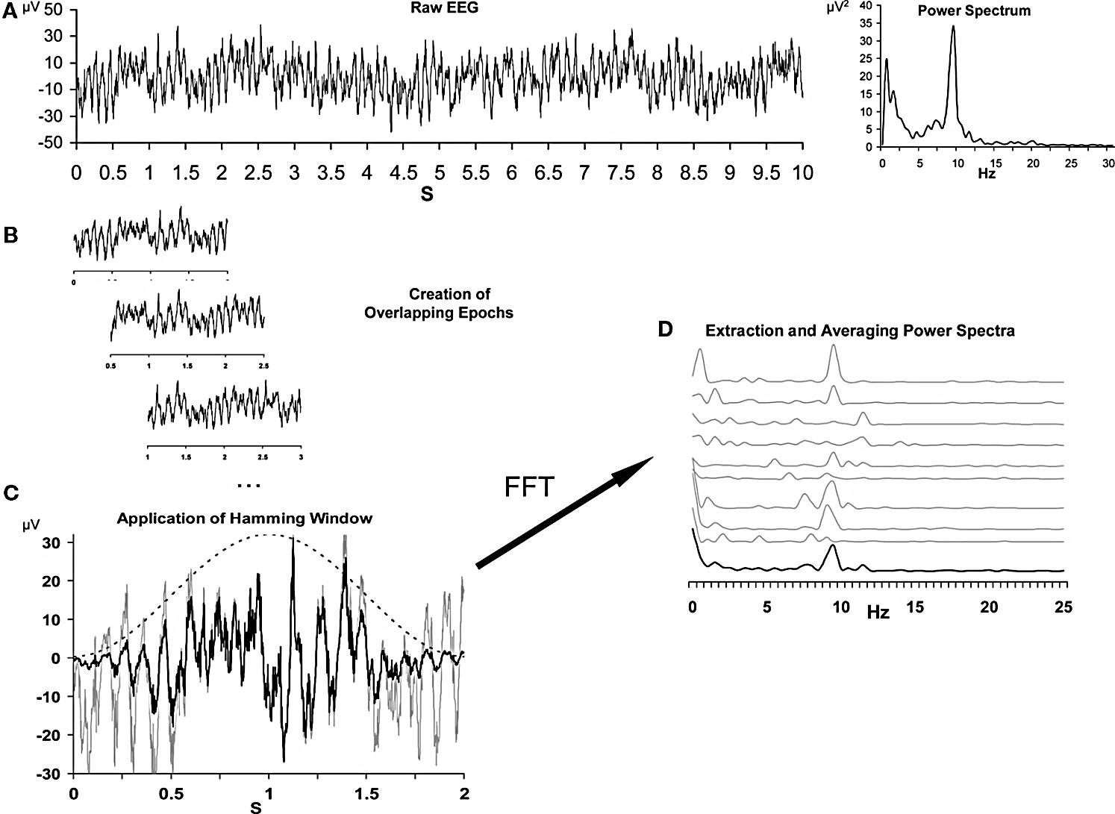
EEG/MEG Frequency Domain Analysis
Source: Allen et. al, 2004
Notes:
Frequency domain analysis:
converting the signal from its time domain to its frequency domain. A → B segment data into epochs B → C use a tapering window to convert the signal C→D compute the FFT D: plot power spectral density
This is how we calculate frequency content. You got to have series of point the differential or change of gradients.

Slide 18
Fieldtrip MATLAB Toolbox
Introduction
Multi-taper
https://www.youtube.com/watch?v=vwPpSglPJTE
Notes:
https://www.youtube.com/watch?v=eUVL_twWNdk
23.33
https://www.youtube.com/watch?v=vwPpSglPJTE
At Fieldtrip 22.48-30.08

Slide 19
MNE Python Script
#Import Modules
import numpy as np #for computing PSDs
import mne # for generating PSDs plots
import matplotlib.pyplot as plt # for plotting PSDs
#Import Functions from mne import io, read_proj, read_selection
from mne.time_frequency import compute_raw_psd
from mne.minimum_norm import read_inverse_operator, compute_source_psd
# Load Data
# Input from preprocessed _raw.fif files
raw_fname='/space/tmsh/1/users/dietta/Wyss_MDD/EEG_MEG/W113/131028/raw_maxf/W113HS2_EO6_SSSmctreocg8_raw.fif‘
raw=io.Raw('/')space/tmsh/1/users/dietta/Wyss_MDD/EEG_MEG/W113/131028/raw_maxf/W113HS2_EO6_SSSmctreocg8_raw.fif
# Set Analysis Parameters
Pxx, freqs = plt.psd
# Computation of Bipolar Montage sensitive to left-right axis
(raw_df[ch_names_diff[i][0]] - raw_df[ch_names_diff[i][1]]
# Set Analysis Parameters for FFT
NFFT=1004 # number of point in the buffer # ( fmax-= 504 ) (Nyquist frequency would ½ (sampling rate)
Fs=1004 # sampling frequency ( data points per second)
Frequency resolution is 1 Hz bins
Nooverlap = 0 # no overlap between windows
# Plot PSDs
plt.plot(freqs[freqs <= 100], 10*np.log10(Pxx_list[0][freqs <= 100]), c='r') # compute and plot LH PSD
plt.plot(freqs[freqs <= 100], 10*np.log10(Pxx_list[1][freqs <= 100]), c='b') # compute and plot RH PSD

Slide 20
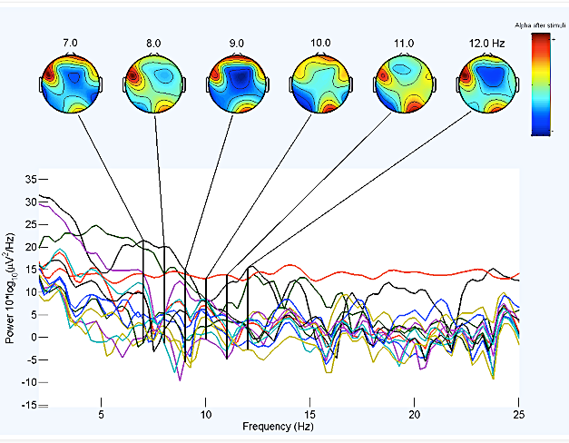
Frontal Asymmetry
Frontal Asymmetry Model: EEG detects less left hemispheric activity relative to the right within the frontal lobe
Source: http://neuroinf.blogspot.com/2014/07/eeg-data-analysis-of-audio-induced-fear.html
Notes:
Neurophysiological Basis and Orientation Sensitivity of EEG and MEG. A. Vertical slice through the cerebral cortex shows three pyramidal neurons (yellow). The EEG and MEG signal are generated at the apical dendrites which are perpendicular to cortical surface. B. The orientation of currents generating the EEG/MEG signals (green arrows) changes with local curvature of the cortex. C. The currents can be divided into tangential and radial components relative to the head model. Tangential currents are generated in sulci and radial currents in gyri (See also panel B). Because magnetic fields radial to the head model are cancelled, MEG does not detect gyral signals whereas EEG detects both gyral and sulcal signals.
Looking at induced fear for frontal asymmetry

Slide 21
Frontal Alpha Asymmetry Scores
(more positive) scores indicate relatively greater left frontal activity
(more negative) scores indicate relatively greater right frontal activity
FAA = (LH) – (RH)
MDD SFS | LH | RH
Frequency (Hz) | Power Values (dB/Hz)
8 | -53.10 | -48.14
9 | -53.11 | -48.14
10 | -53.86 | -49.44
11 | -54.30 | -51.07
12 | -54.68 | -51.99
AVG | -53.98 | -52.45
Frontal Asymmetry | -1.53
Notes:
Frequency domain analysis:
converting the signal from its time domain to its frequency domain. A → B segment data into epochs B → C use a tapering window to convert the signal C→D compute the FFT D: plot power spectral density
This is how we calculate frequency content. You got to have series of point the differential or change of gradients.
FAA scores are defined based on Allen et. al less left frontal activity in comparison to right frontal lobe

Slide 22
Outline
Introduction
Methods
Data Collection
Preprocessing
Analysis
Results
EEG, MEG, MEG Cortical Space
Discussion

Slide 23
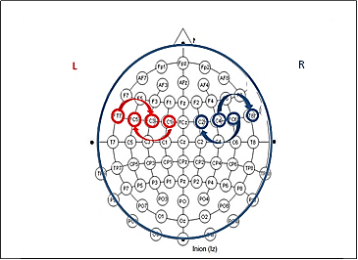
EEG Channels
Source: Figure 5
Notes:
Current is half way between those sensors

Slide 24
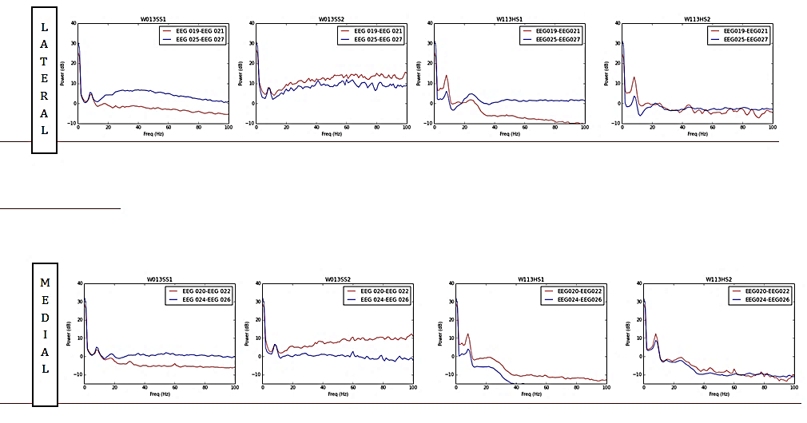
MDD EEG PSD plots
MDD V1
MDD V2
Source: Figure 6
Notes:
Widen db/Hz scale along y-axis

Slide 25
EEG Sensor Results
EEG Bipolar
Frequency Band |  | MDD V1 | MDD V2 | Control V1 | Control V2
 | Lateral
ALPHA (8-13Hz) | Frontal Asymmetry | -1.0 | 1.21 | 4.94 | 6.69
 | Medial
 | Frontal Asymmetry | -0.86 | 1.19 | 5.25 | 1.31
Source: Table 3
Notes:
EEG Sensor Space Asymmetry
Consistent with past studies, hypo activation (left < right) in the depressed subject in comparison to the healthy subject was seen in the EEG sensor space results. 40% less LH activity in the depressed in comparison to the healthy control.
A decrease in lateralized activity was seen post treatment for MDD patients with over 100% increase in LH activity.
Further investigation is necessary for more in depth interpretations of this data
It would be appropriate to compute the average of the power spectra plots
Divide the power by the mean of the power to normalize the curves (they were steep lines) into flat lines with spikes at the important frequency contents

Slide 26
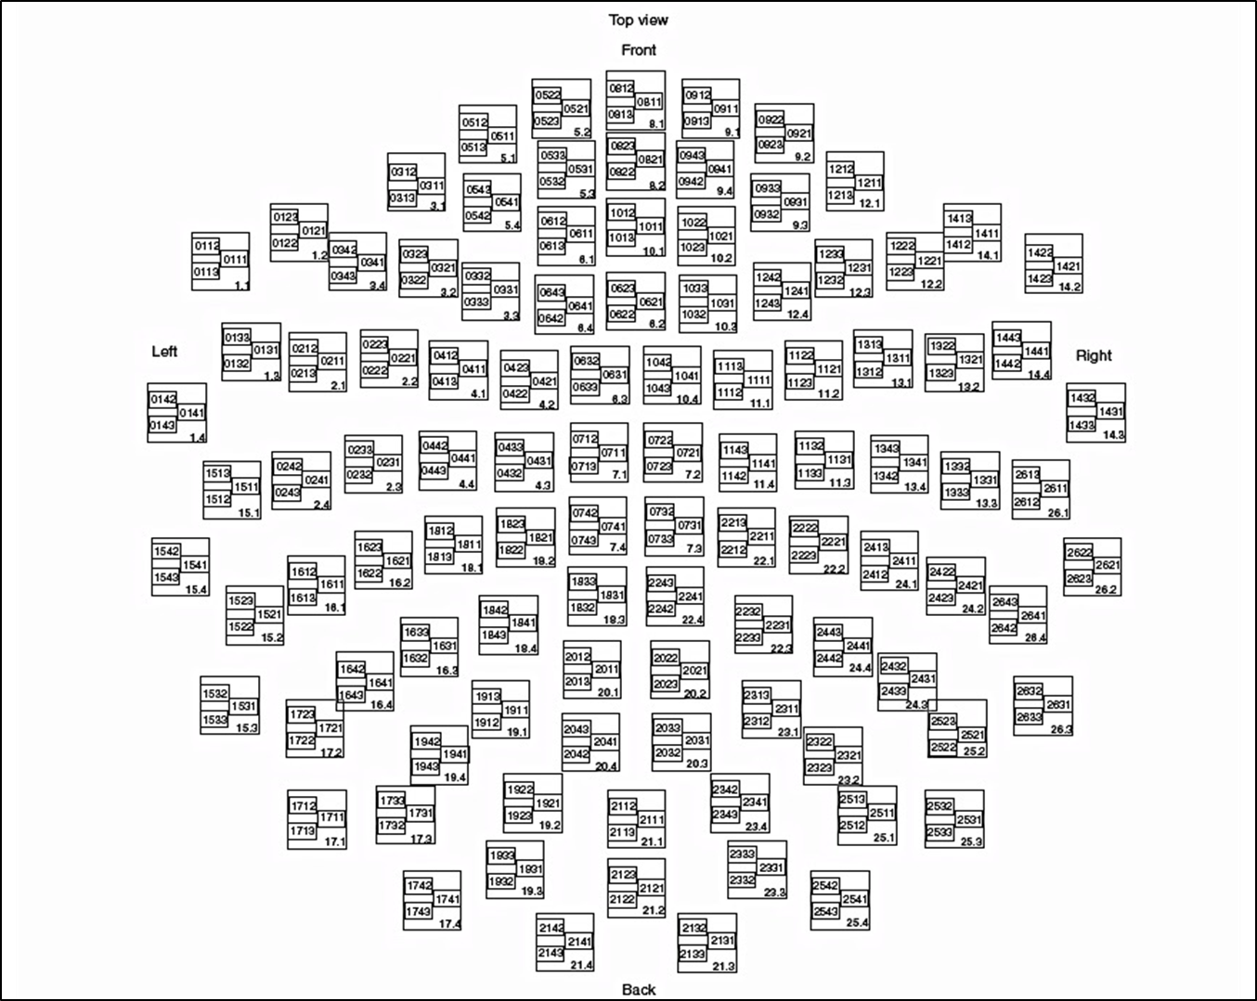
MEG Helmet
L
R
Source: Vectorview Manual, 2009

Slide 27
RESULTS CORTICAL SPACE

Slide 28
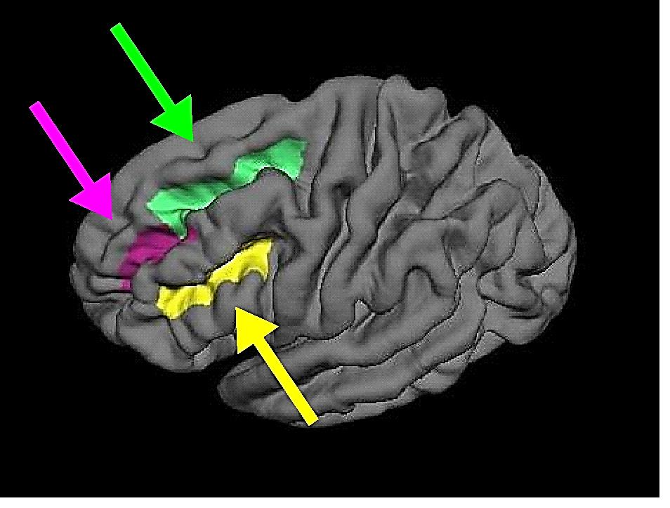
Cortical Labels
Source: Figure 5

Slide 29
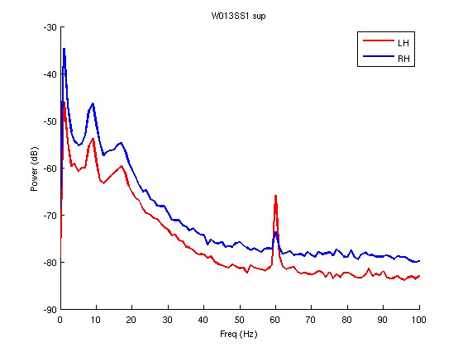
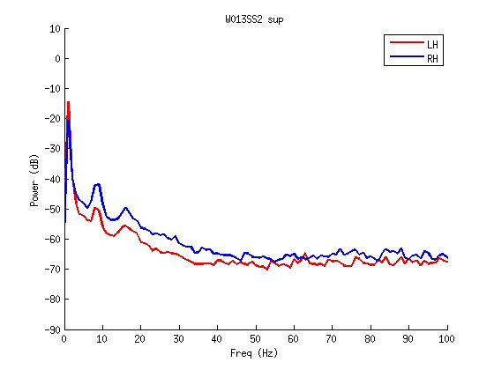
MEG Cortical Space Results Superior Frontal Sulcus
MDD V1
MDD V2
Source: Figure 8

Slide 30
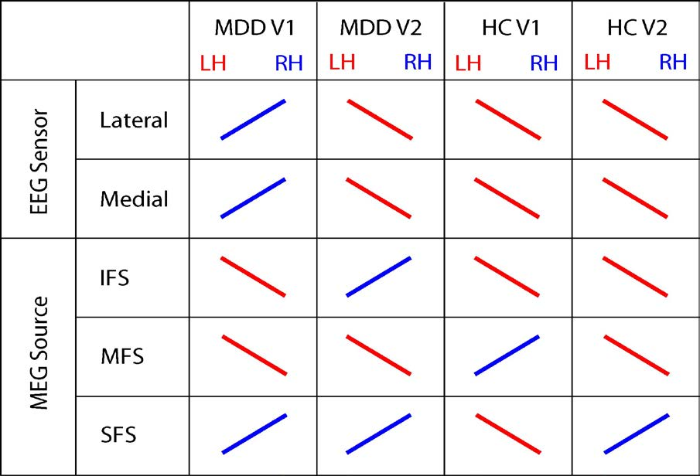
Summary
Source: Table 6

Slide 31
Outline
Introduction
Methods
Data Collection
Preprocessing
Analysis
Results
EEG, MEG, MEG Cortical Space
Discussion

Slide 32
Discussion
Frontal Alpha Asymmetry exists for MDD patient
For MDD, FA changes after treatment
Superior Frontal Sulcus shows evidence of FA
Supports FA for biomarker in MDD
Extensions: need more subjects !
More exploratory questions to be answered
Trait versus State
Sensitivity and Specificity

Slide 33
Future Directions
More data
Better Methods
Better theoretical interpretations of FA

Slide 34


Thank You!!
Titipat Achakulvisut, MSc
Intern at Allen Institute
https://github.com/titipata
Mohammad Azar, PhD
Scientist at Google DeepMind
MIT-AI Article

